Slide 1
X-Trade
Online Trading Platform
Java EE
Customize for XMUM students and staffs

Slide 2
TABLE OF CONTENTS
01
04
Our Team
Difficulties faced
02
05
Introduction
Future Improvement
03
06
Case Studies
Conclusion

Slide 3
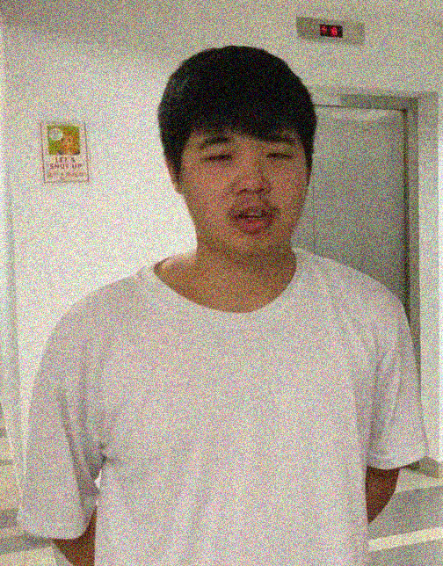
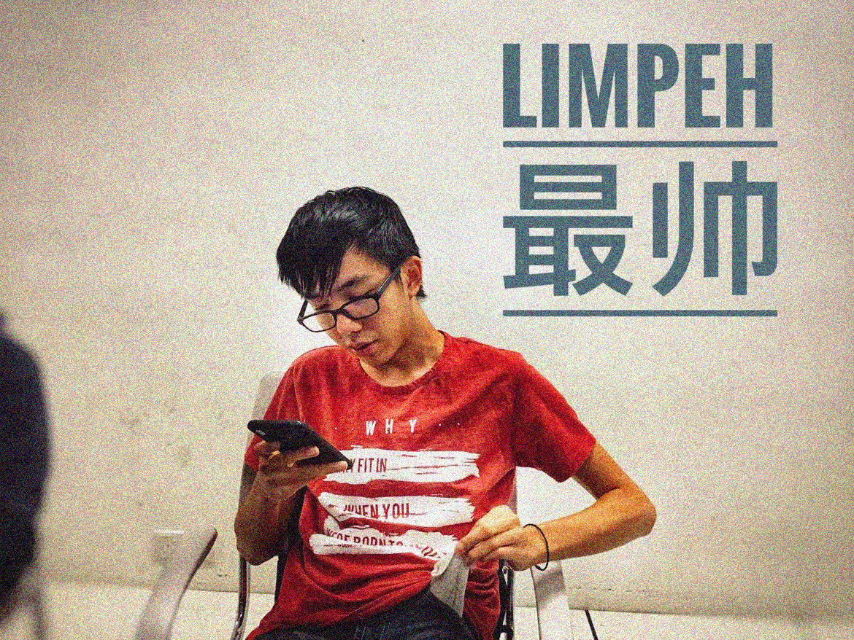

OUR TEAM
Gary Tan
Jack Khor (Leader)
Wei Jun
Tan Ting Yi SWE1809659
Khor Jia Cheng SWE1809651
Leong Wei Jun SWE1809654

Slide 4
Introduction
Many Social Media’s Second-hand Trading market Groups
Develop a Website specially for XMUM Staff and Student

Slide 5
WHAT WE ARE WORKING ON
Java Servlets
MySQL
Apache Tomcat
The central
Database
Web Container

Slide 6
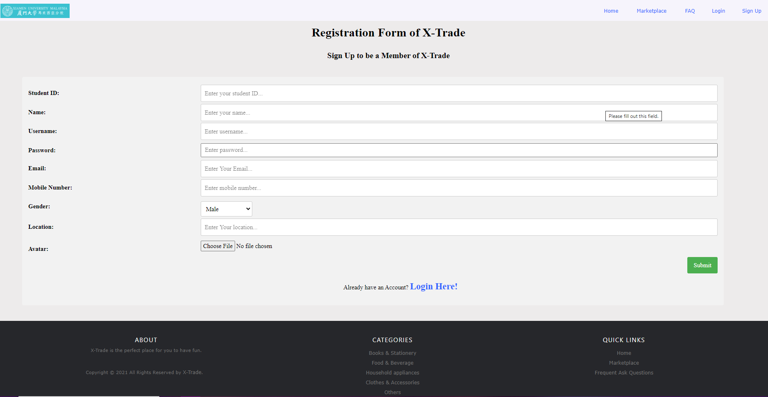
Case Studies
Registration

Slide 7
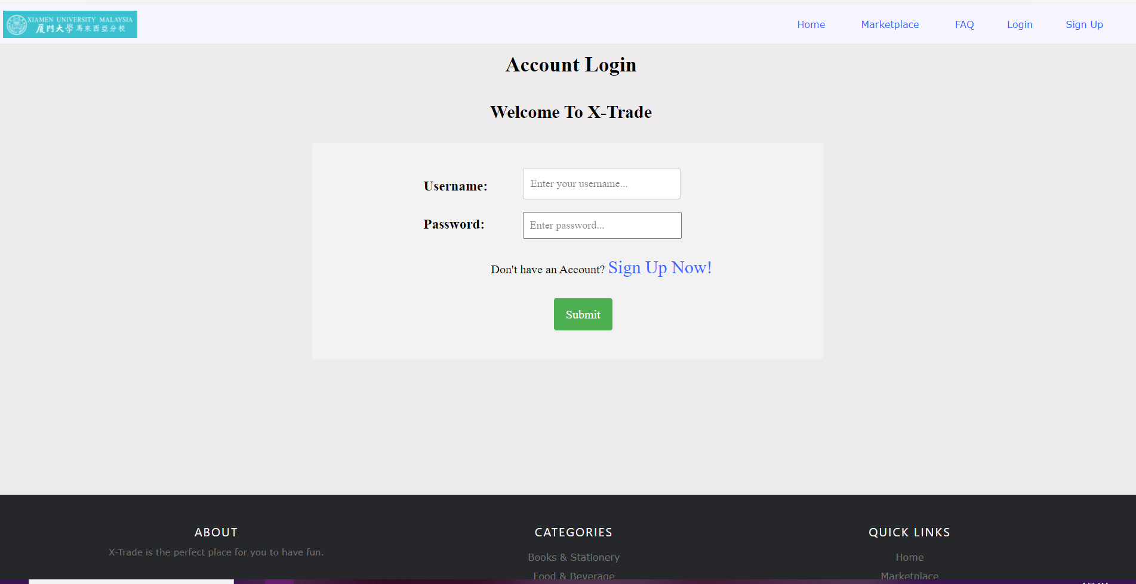
Case Studies
Login

Slide 8
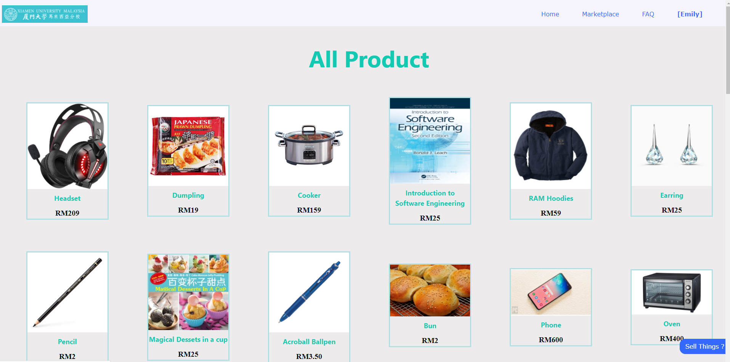
Case Studies
Browse Product

Slide 9
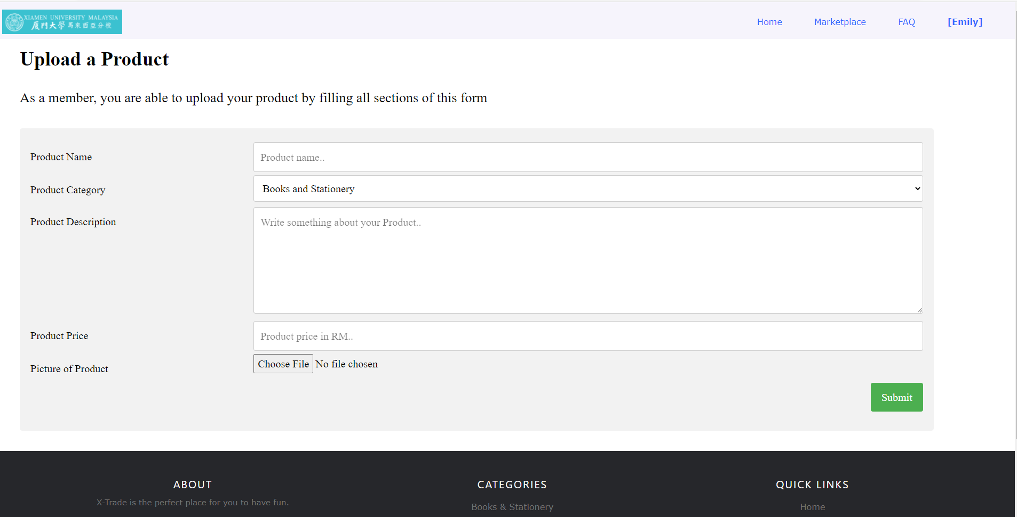
Case Studies
Product Upload

Slide 10
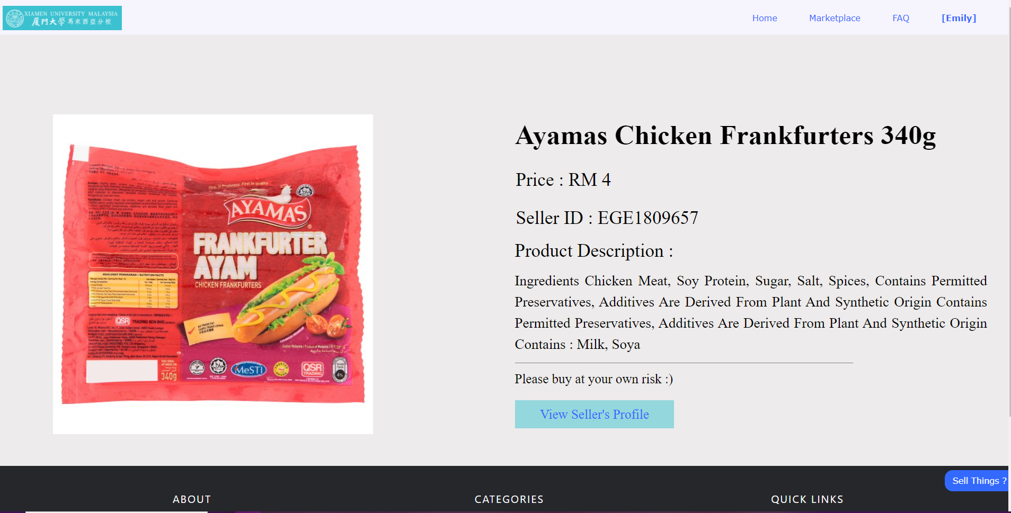
Case Studies
Product Details

Slide 11
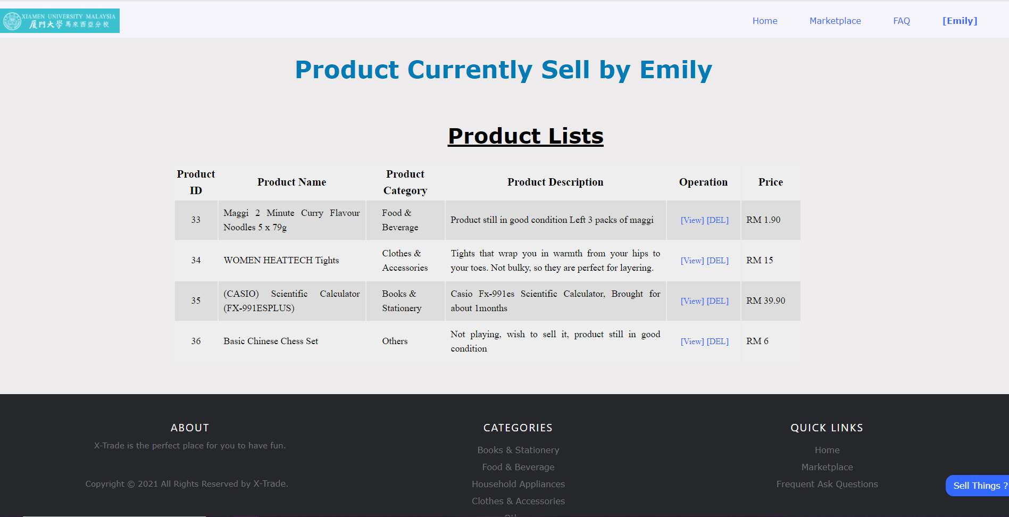
Case Studies
View Currently Sell Products

Slide 12
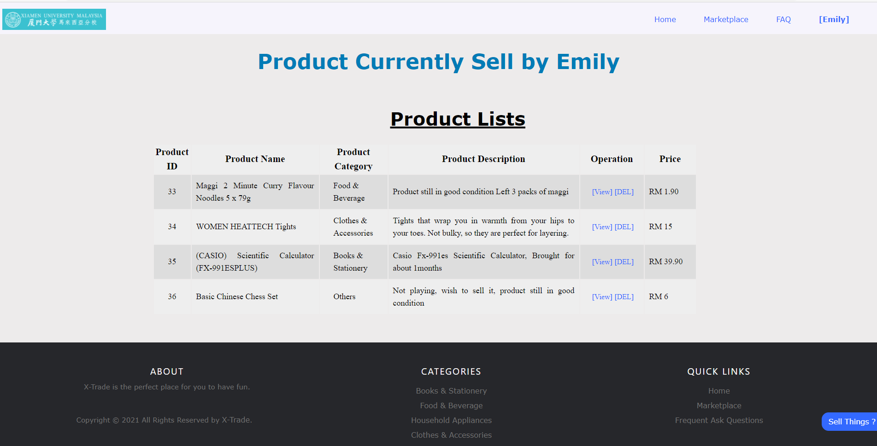
Case Studies
Product Delete

Slide 13
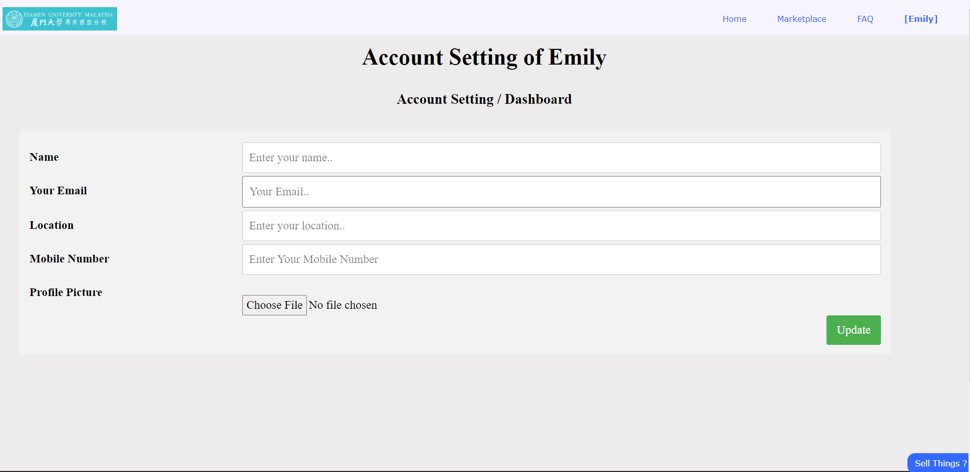
Case Studies
Change User Account Settings

Slide 14
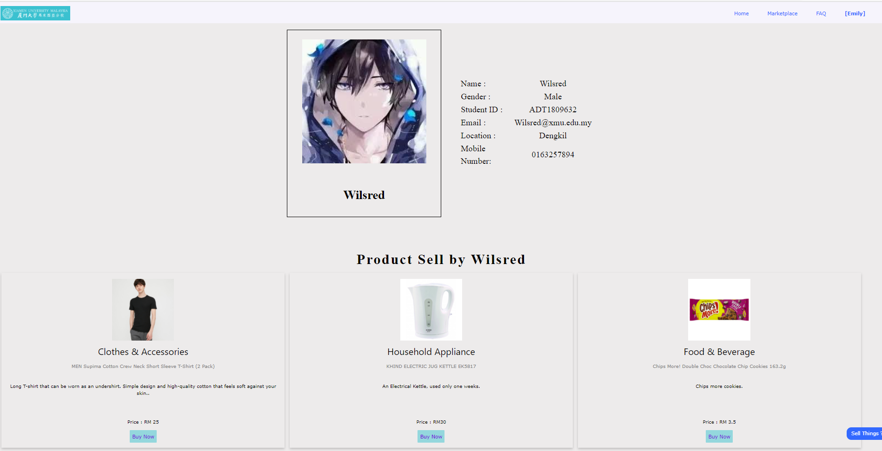
Case Studies
Seller Profile

Slide 15
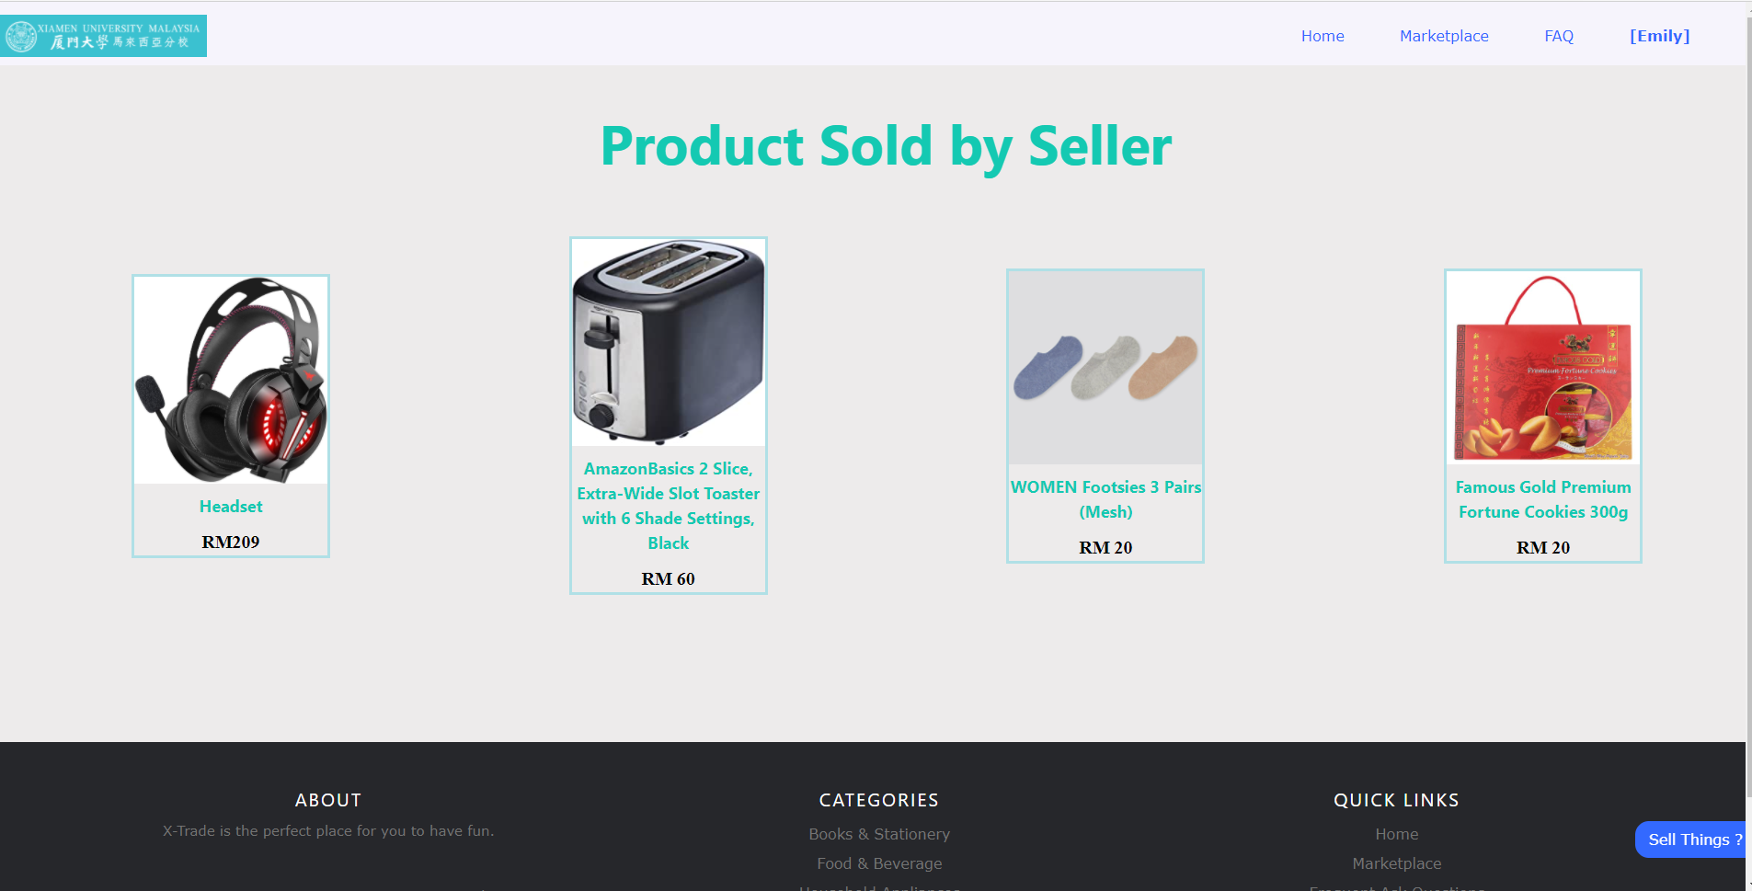
Case Studies

Slide 16
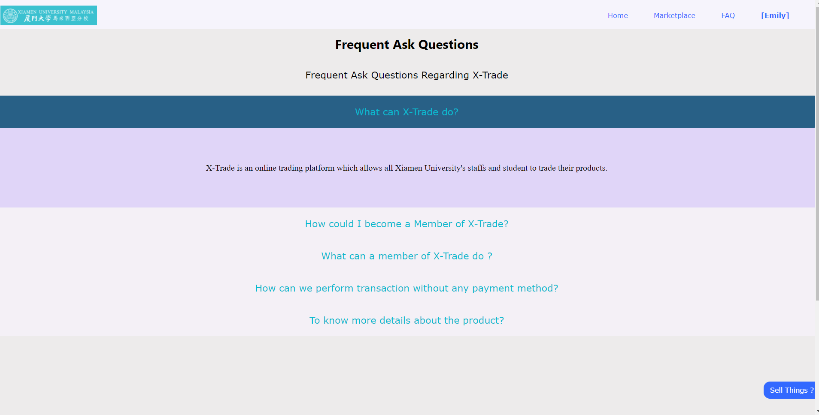
Case Studies
FAQ

Slide 17
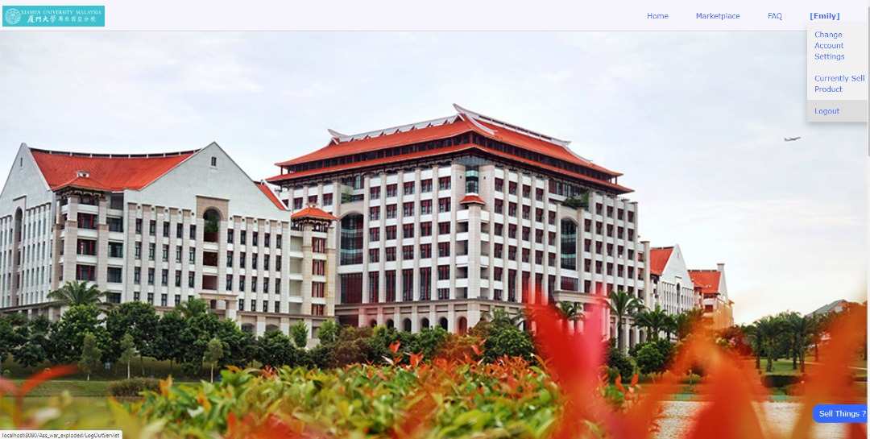
Case Studies
Logout

Slide 18
Difficulties Faced
Flexbox as Container
Actors role
Payment Method
Image Display
Responsive Website
Inbox
Container could not display different size image
Local Computer Image could not be shown
Admin
- Time Constraint
- Lack of Functionality
Website display normally only in full-sized window
None, only face-to-face transaction.
We make the front-end part but failed to connect it.

Slide 19
FUTURE
Inbox
Payment Method
Responsive Website

Slide 20
Conclusion
HTML
CSS
Java
Java EE
SQL
Apache Tomcat
Servlet
X-Trade

